Slide 1

Personal Loan Modelling
Group assignment
Jade Reyes & Jes Colbourne

Slide 2

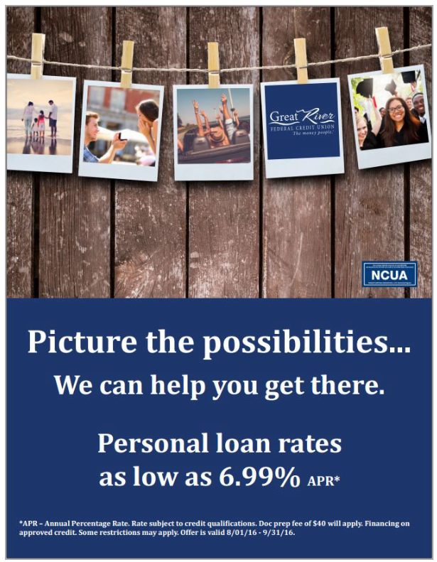
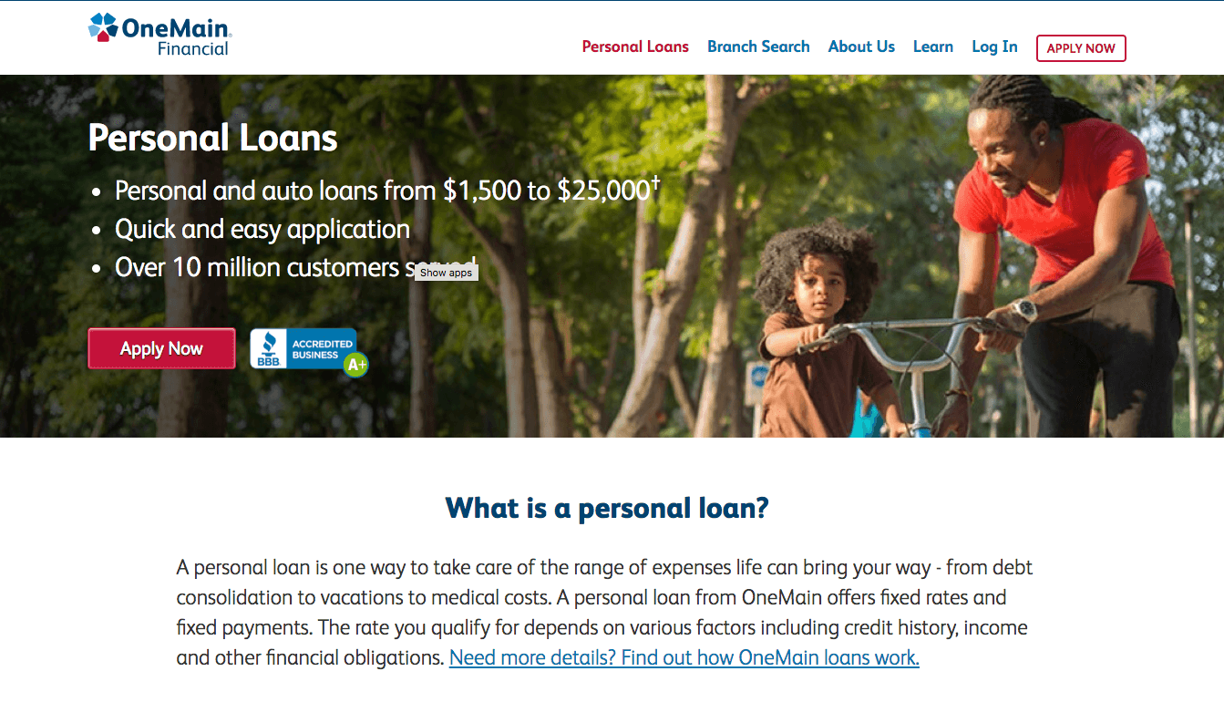
Business Context
Thera Bank (fictional) wants to explore ways to getting more personal loan customers
More people to expose these ads to requires more budget

Slide 3


Business Question
Develop a classification model which will allow Thera Bank’s marketing team to maximise conversion rate of Personal Loan Campaign by limiting the target audience with minimal budget.

Slide 4
Data
INTEGER/STRING
BOOLEAN (1 or 0)
Age ( Customer’s Age in years)
Experience(Number of years in professional experience)
Annual Income of customer
Zip Code
Family (Family size of customer)
CCAverage (Avg spending on credit card per month)
Education (Undergrad, Graduate, Advance/Professional)
Value of house mortgage
Personal Loan
Securities Account
Online
CD Account
Credit Card
Target Variable
https://www.kaggle.com/datasets/teertha/personal-loan-modeling?select=Bank_Personal_Loan_Modelling.csv

Slide 5
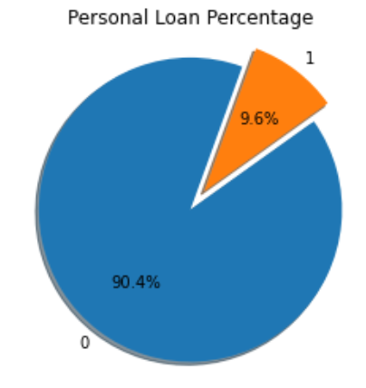
Data
JES’ Approach
Randomly sampled 400 datasets for both populations
Joined these 2 x 400 data set into one dataset
Performed train test split on this 800 dataset
Trained the model in this data set
JADE’s Approach
Imported “SMOTE” from imblearn.over_sampling
SMOTE - Synthetic Minority Over-sampling Technique
This creates more synthetic entries of the minority to match up number of majority class
From 5000 data point this increased to 9,040 data points

Slide 6
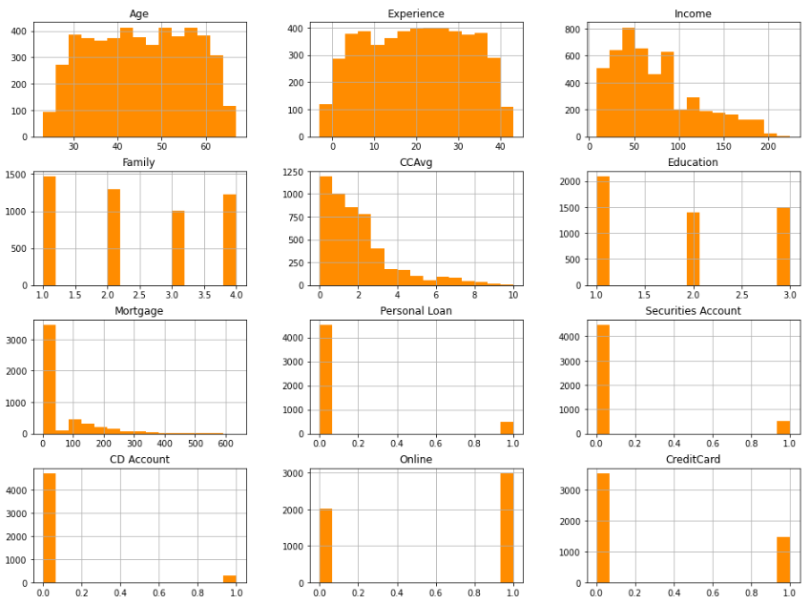
Exploratory Data Analysis
Age is normally distributed
Income skewed to the lower incomes
Experience has negative values

Slide 7
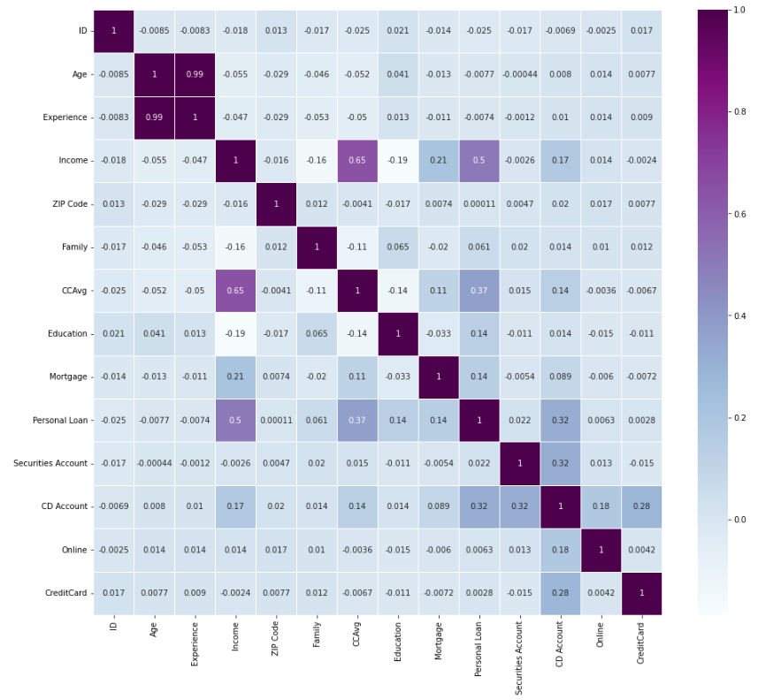
Exploratory Data Analysis

Slide 8
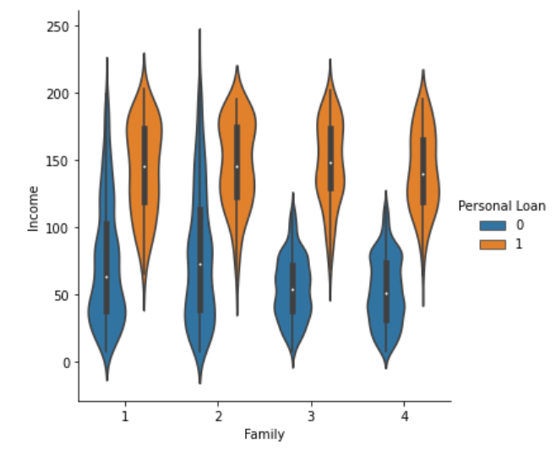
Income by Family Size
Everyone earning above 135K a year and has a family size of more than 3 has a Personal Loan

Slide 9
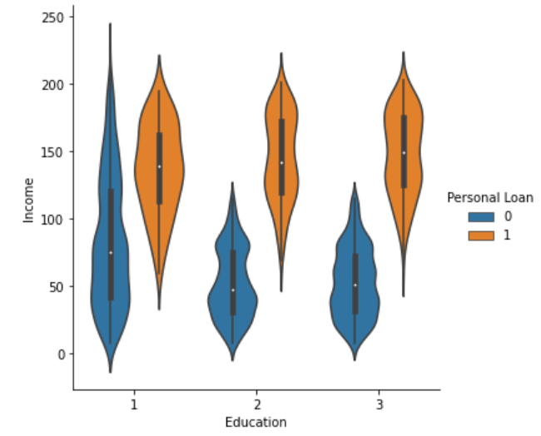
Income by Educational Attainment
Everyone earning above 135K a year and is a graduate has a personal loan

Slide 10
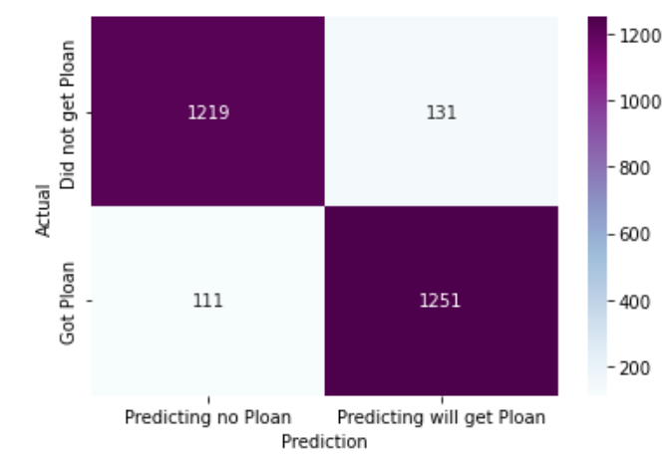
LOGISTIC REGRESSION
Parameters: solver = liblinear
METRIC | SCORE
Accuracy | 91.08%
Precision | 90.52%
Recall | 91.85%
F-1 | 91.18%

Slide 11
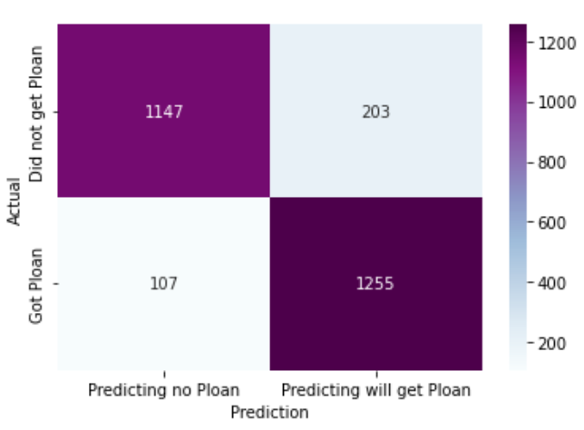
SUPPORT VECTOR MACHINE
Parameters: C=1, kernel = linear
METRIC | SCORE
Accuracy | 88.57%
Precision | 86.08%
Recall | 92.14%
F-1 | 89.01%

Slide 12
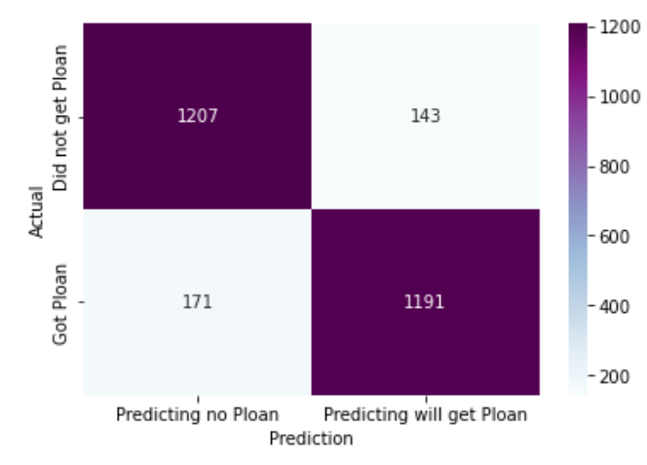
Gaussian Naïve Bayes
Default Parameters
METRIC | SCORE
Accuracy | 88.42%
Precision | 89.28%
Recall | 87.44%
F-1 | 88.35%

Slide 13
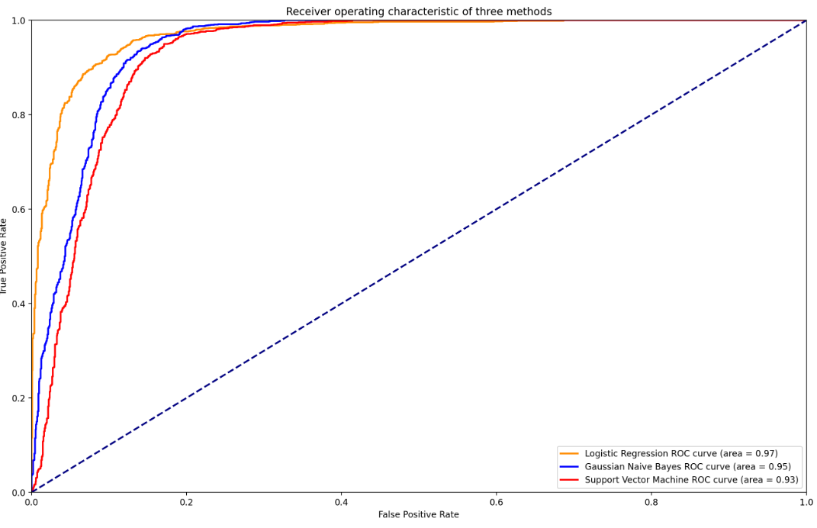
ROC AUC
Can we plot Support vector machines?
There is no Predict Probabilities, I only used decision function for SVM

Slide 14
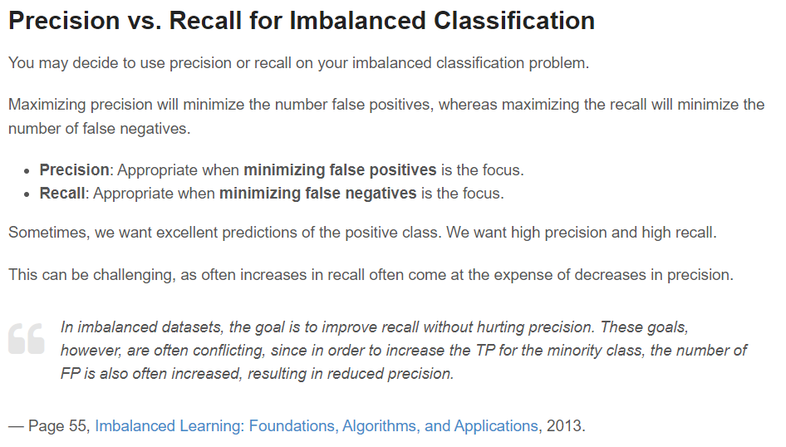
Recommended Model
Model | Accuracy | Precision | Recall | F1
Logistic Regression | 91.08% | 90.52% | 91.85% | 91.18%
Support Vector Machine | 88.57% | 86.08% | 92.14% | 89.01%
Gaussian Naïve Bayes | 88.42% | 89.28% | 87.44% | 88.35%

Slide 15
Cross Validation
Accuracy Scores
91.5%
90.1%
91.5%
90.7%
90.9%
Average Score : 90.94%

Slide 16
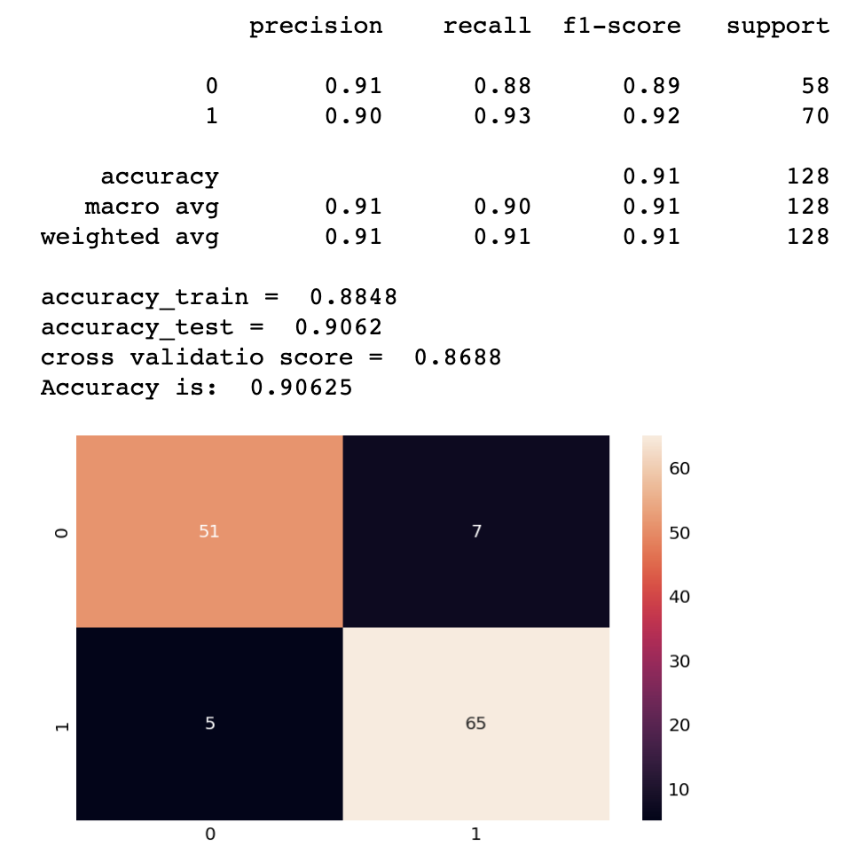
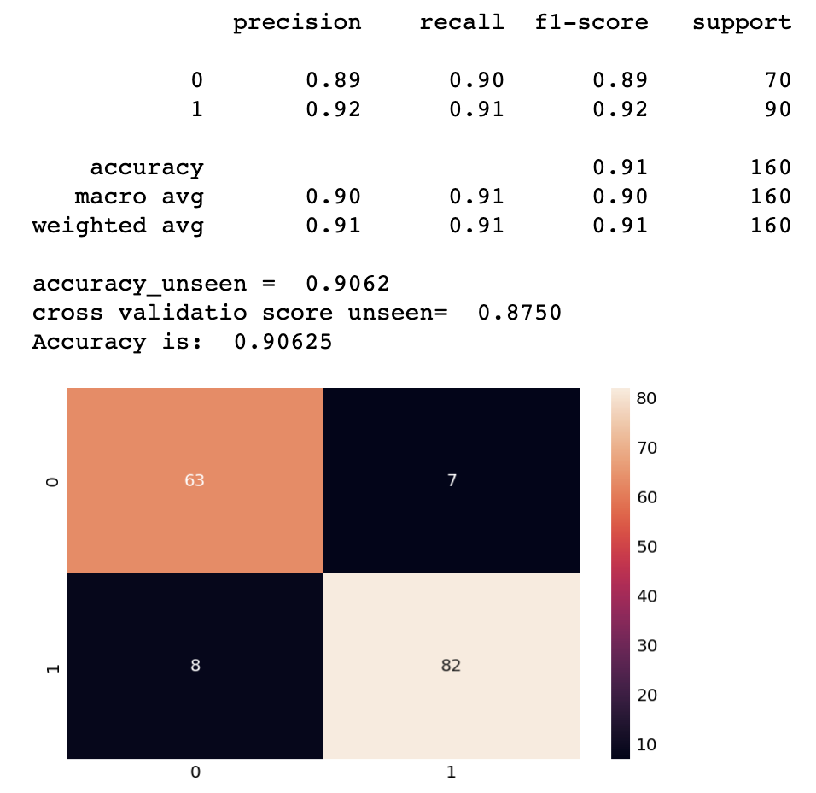
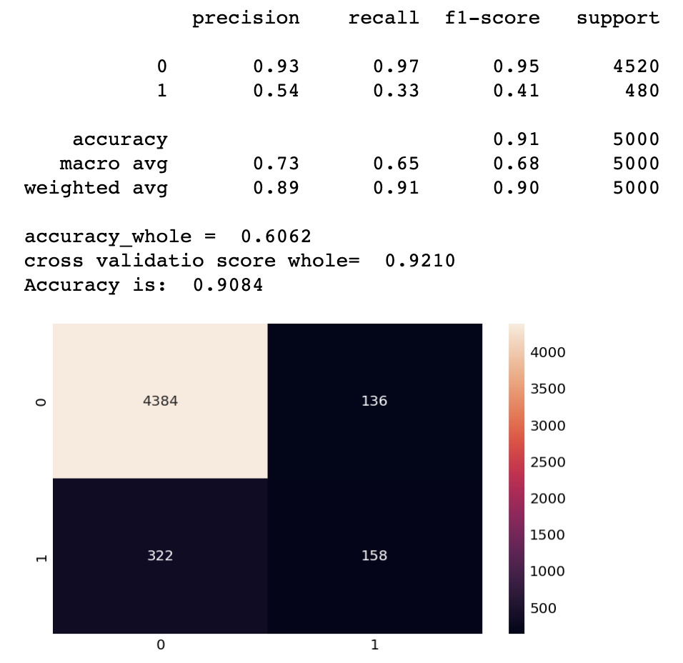
Logistic Regression Model with all features
Training
Unseen
Whole

Slide 17


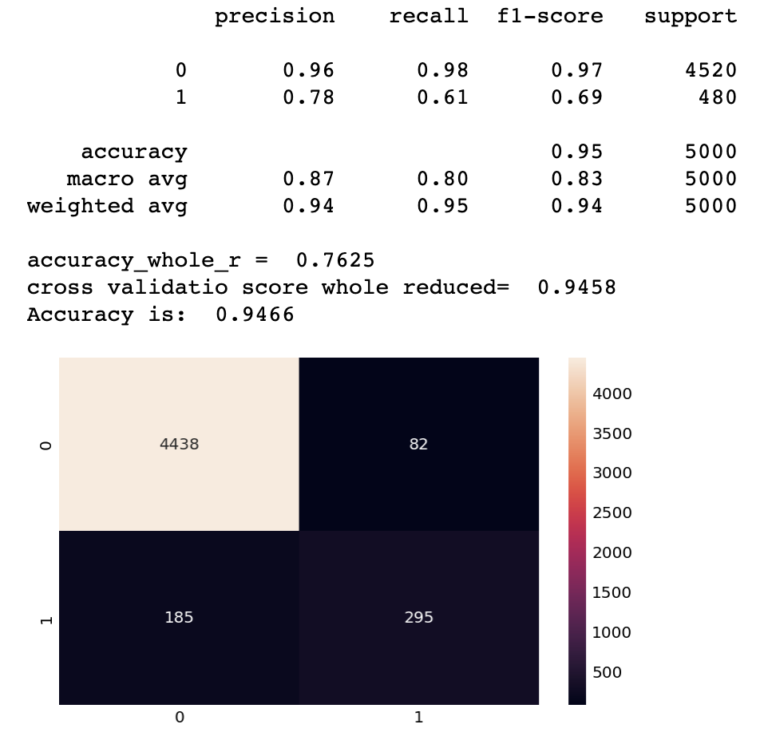
Logistic Regression Model with reduced features
Training
Unseen
Whole

Slide 18

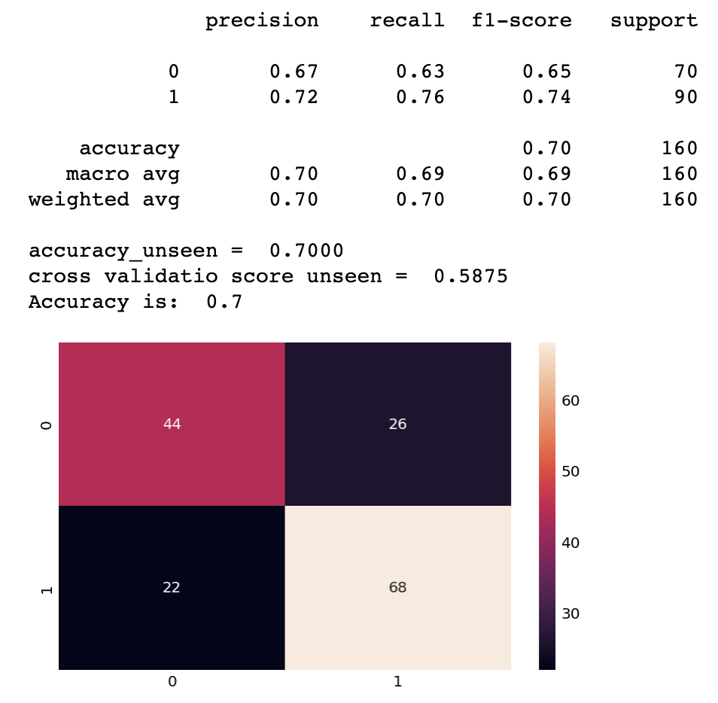
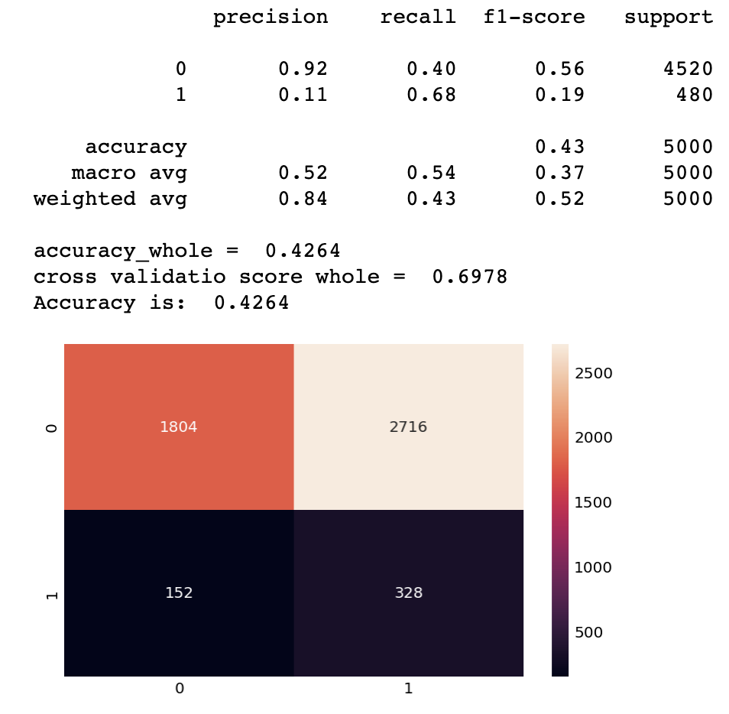
Support Vector Machine Model with all features
Training
Unseen
Whole

Slide 19
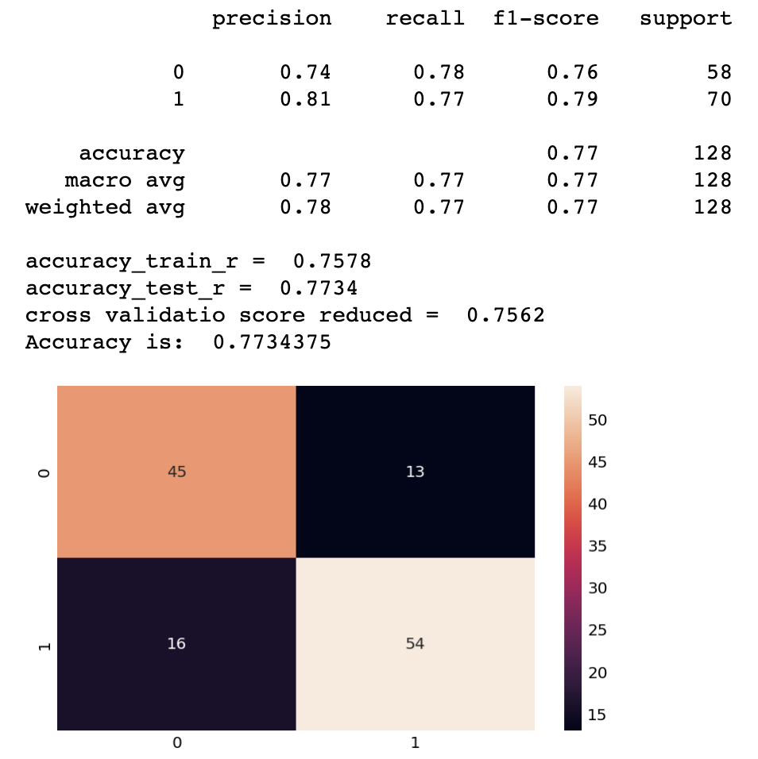
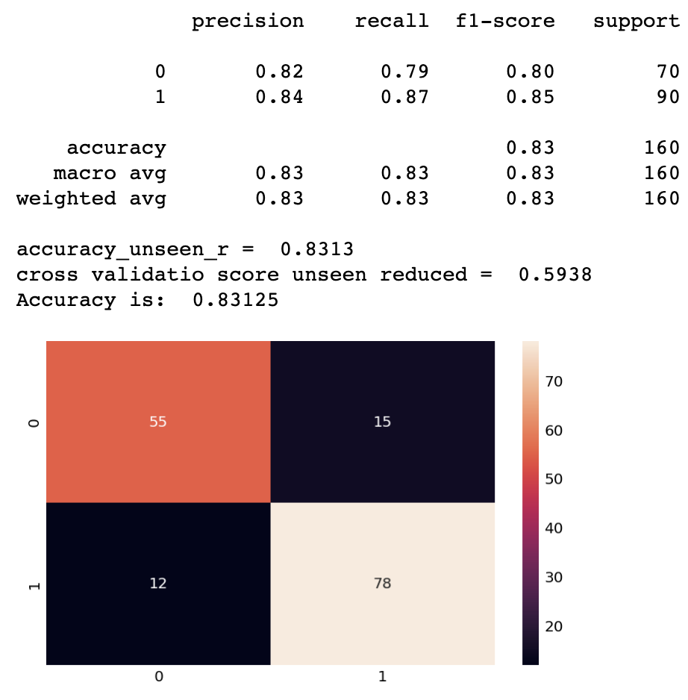
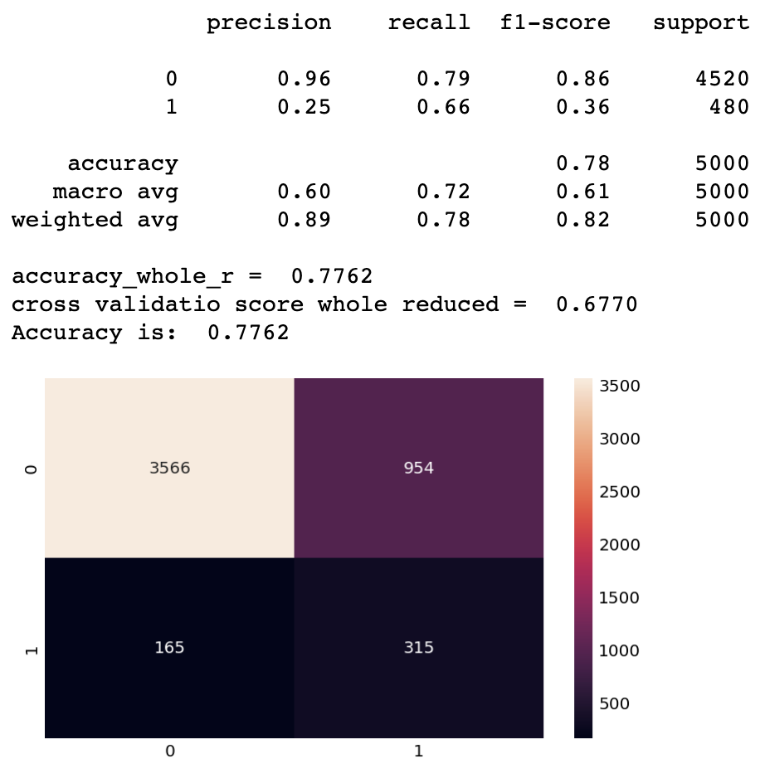
Support Vector Machine Model with reduced features
Training
Unseen
Whole

Slide 20
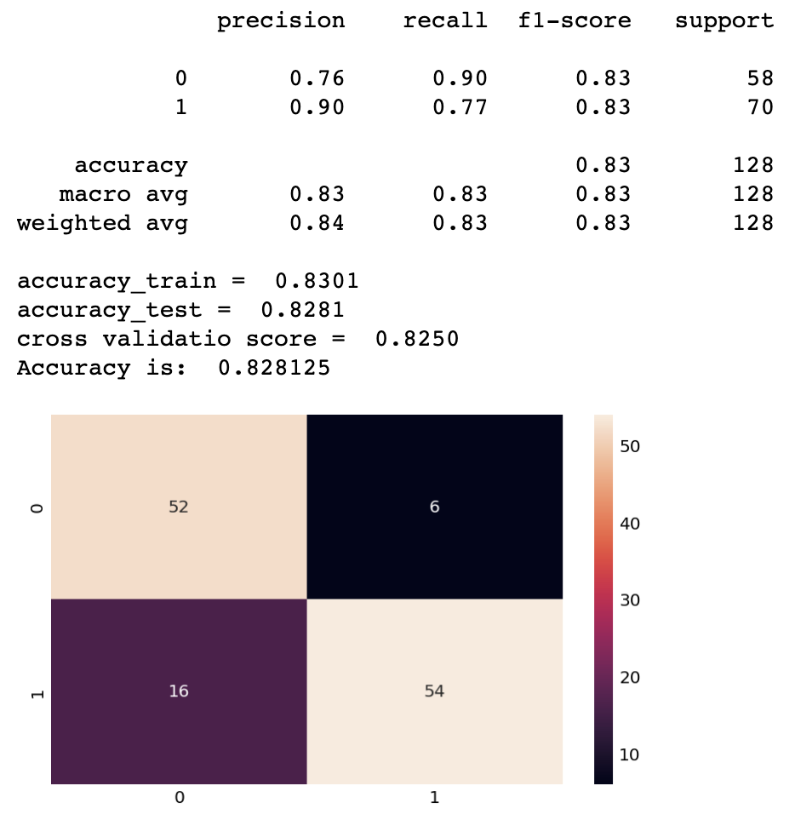
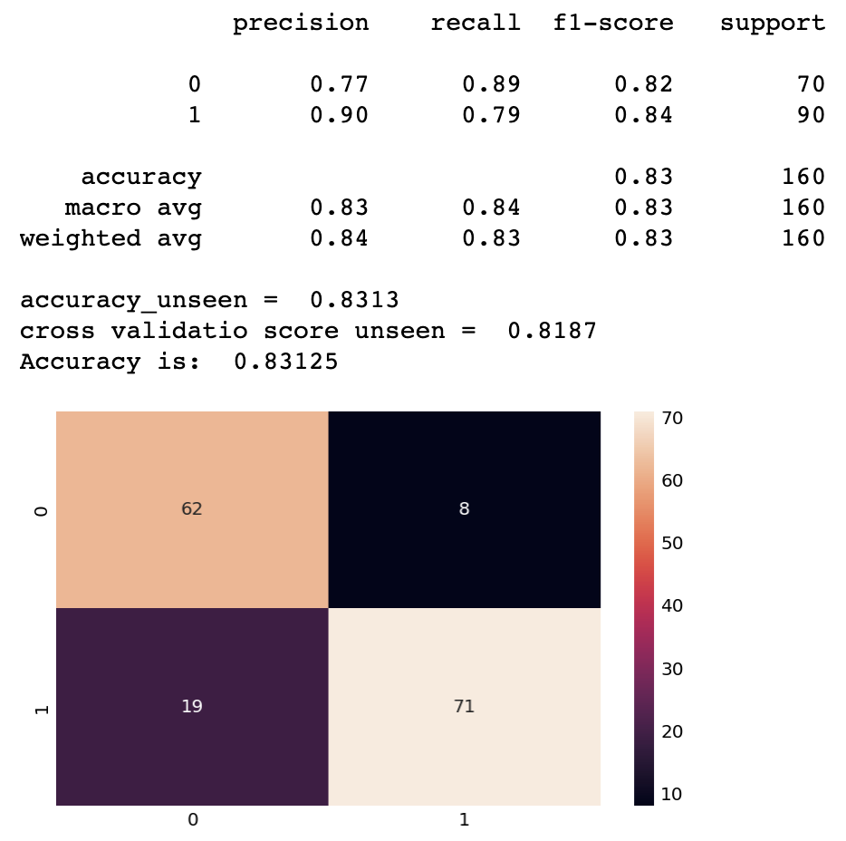
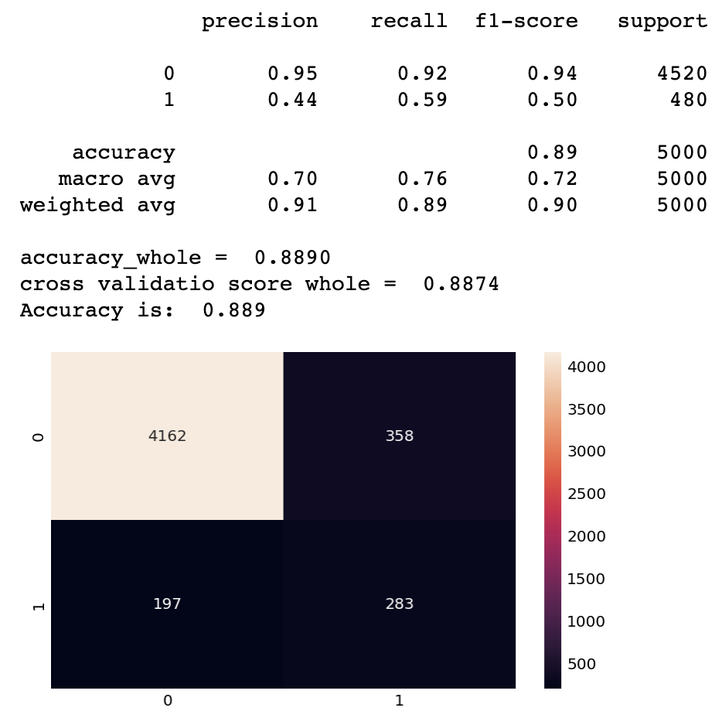
Naïve Bayes Model with all features
Training
Unseen
Whole

Slide 21
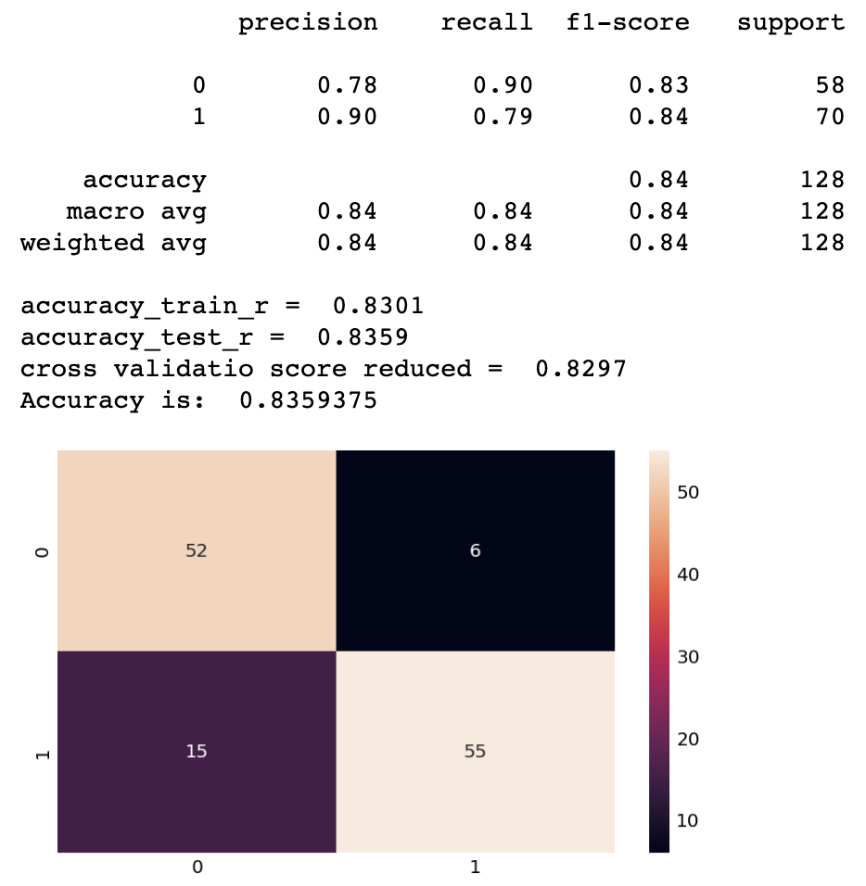
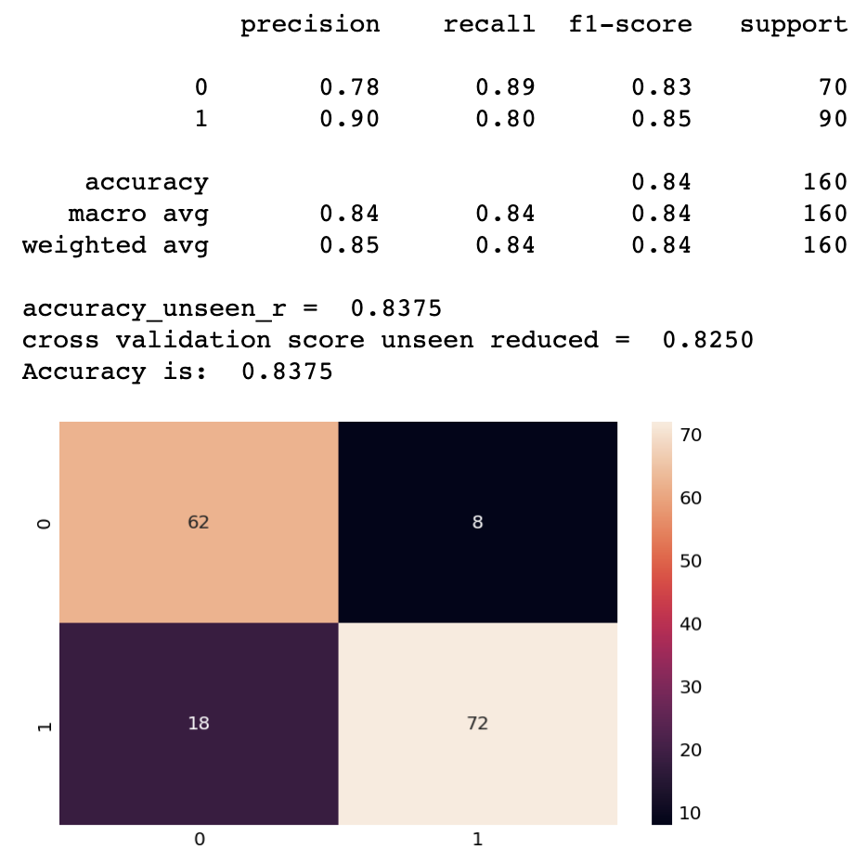

Naïve Bayes Model with reduced features
Training
Unseen
Whole

Slide 22
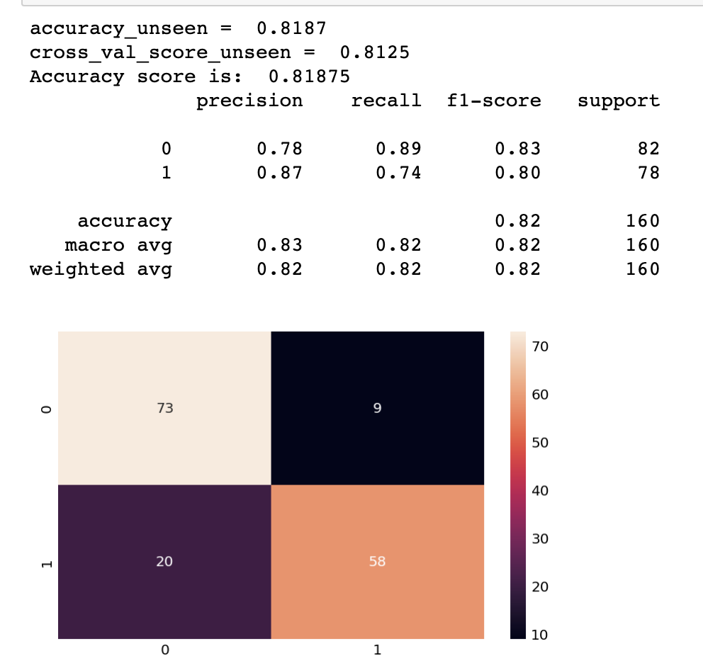
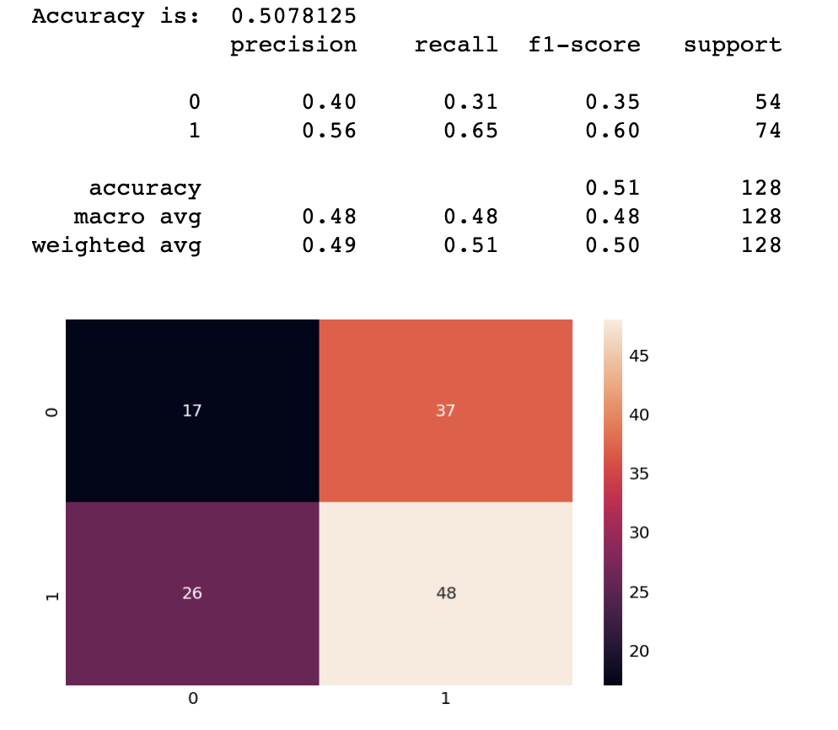
Naïve Bayes with reduced features (income, family, education, ccavg, mortgage, cd_account, online)
Training set
Unseen set
accuracy_train = 0.8125 accuracy_test = 0.7969 cross_val_score: 0.8109375

